Slide 1
TODO
Add a link/QR code to the web portal on slides “Registration” and “Registration confirmation”
Update the front page screenshot of the web portal on several slides that all have the text (NOTE: Update screenshots!) in the speaker notes window. Actually, update all screenshots. In this moment there is a sandbox version used.
@Sylvia: Please add information to the speaker notes of “Modify the…” slide.
Create a link to a Padlet, Ekimo, Taskcard or Conceptboard for the “Reflection and Feedback” at the end of this module.
Add an overview of modules image with module 3 highlighted for the “Outlook” slide
Notes:
Note: www.taskcards.de/ or conceptboard.com/ – DGPR compliant: apps are good for Mindmaps, Conceptmaps, Brainstorming – Alternatives to Padlet

Slide 2
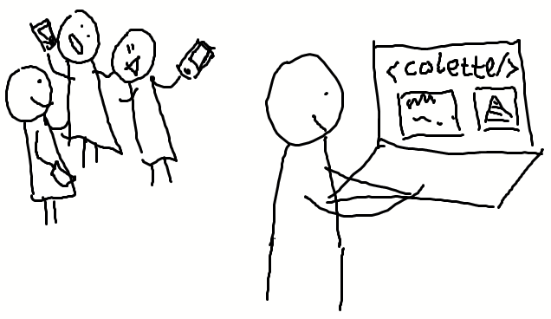
The <colette/> Web Portal
Introduction Workshop for Teachers Computational Thinking Learning Environment for Teachers in Europe
Computational Thinking Learning Environment for Teachers in Europe (colette-project.eu)
Notes:
Welcome to the second module on <colette/> my name is … and together we are going to familiarize ourselves with the teacher perspective of <colette/> today - namely by looking at and trying out the Web Portal.

Slide 3
Module 1:
Theoretical Background and <colette/>-App from Students’ Perspective
90 Minutes
Module 2:
Introduction of <colette/> Portal from Teachers’ Perspective
45 Minutes
Module 3:
Creation of a task sequence in the <colette/> web portal, mutual assignment and feedback
120 Minutes
Module 4:
Embedding <colette/> in regular classes
120 Minutes

Slide 4
Ideas
Explain that the portal is teachers’ tool to
Create paths/tasks
Delete paths/tasks
Manage paths/tasks
Explain the concept of Paths
Specific sequence of tasks
Students can access the path in the app, using the unique path code
Explain the concept of Tasks
Tasks are organized into families of tasks
Each task family includes various scenarios
Teachers can select if students should
Select/Create code blocks and sequence them (Implement code)
Re-arrange and piece together given code blocks or code fragments (Parsons puzzle)
Find the error in a given code (Find the error)

Slide 5
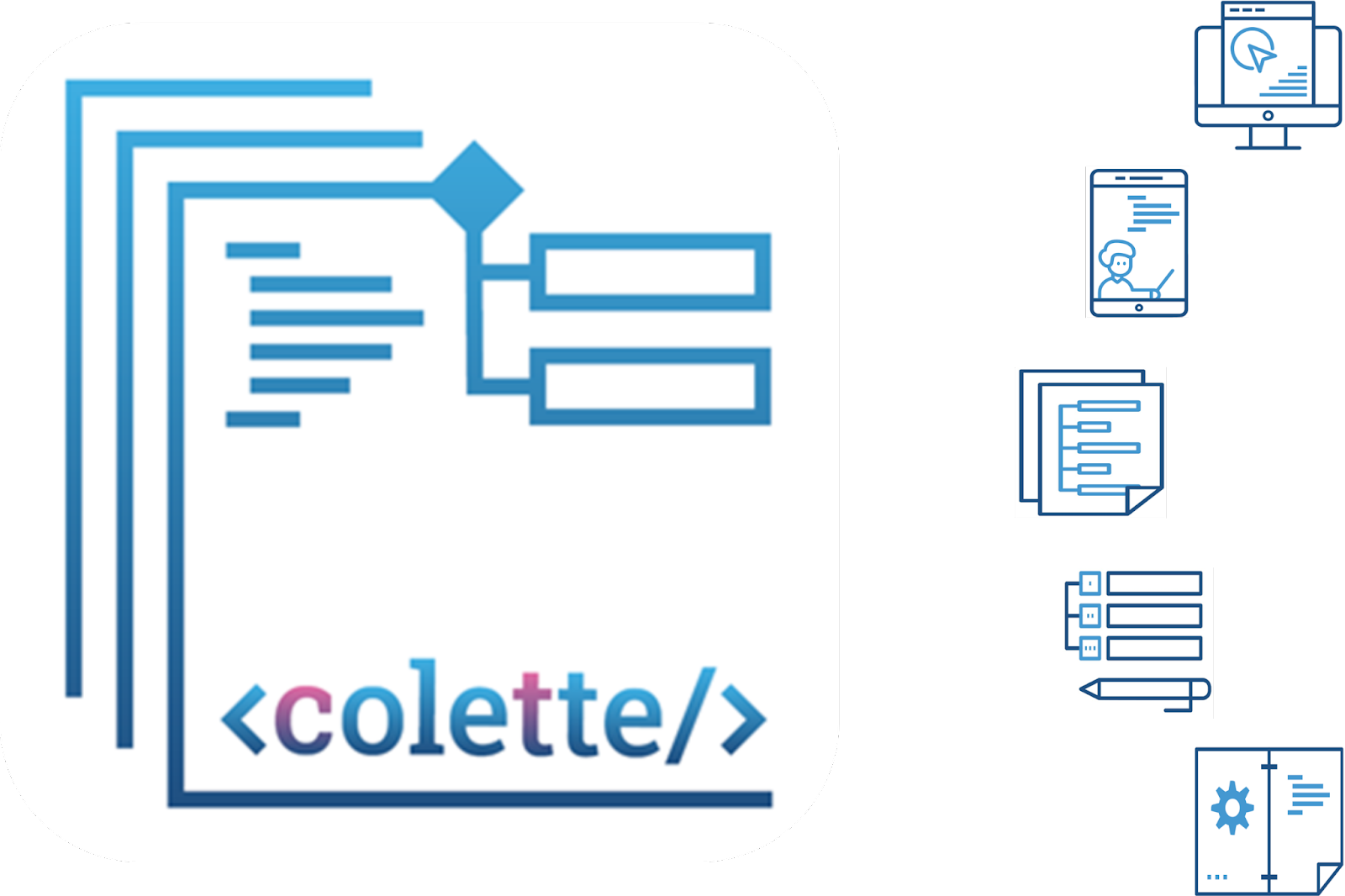
Aspects of <colette/>
Our focus today
Web portal for
teachers
App for students
Tasks that integrate CT into school mathematics
Teacher trainings
Handbook for
educators and
teachers
Notes:
Like we mentioned in the first module, <colette/> is a twofold system. The students’ side is the mobile phone (or tablet) application - that we already tried out in the first module - and the teacher or developer side is the web portal - that we will get a first impression of in this second module. Inside the web portal is a link to a handbook which exists to support teachers’ work of implementing computational thinking into classrooms using <colette/>.

Slide 6
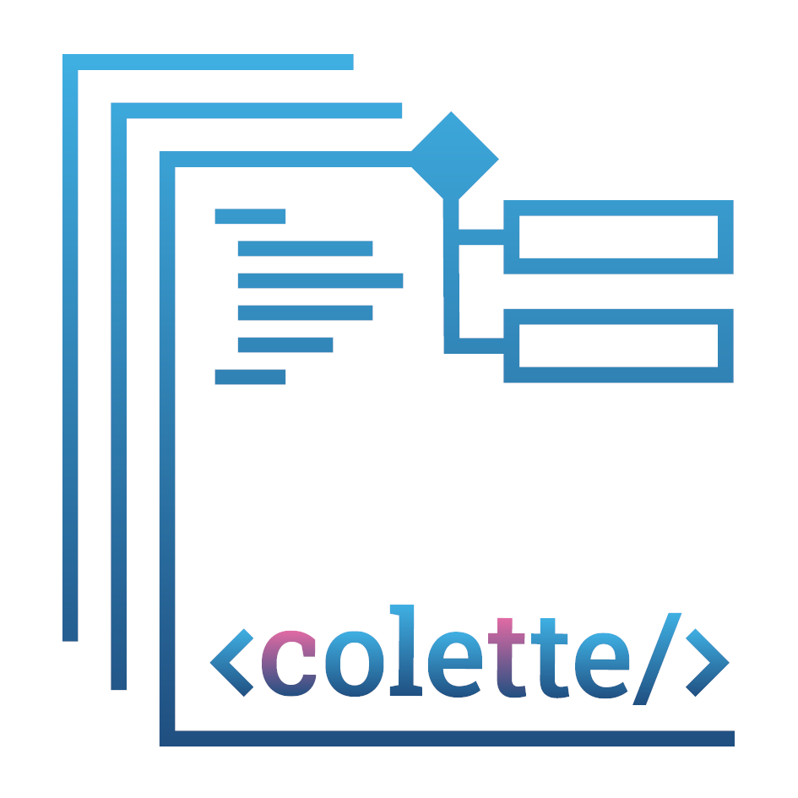
In this Module
<colette/> is a two-component system
Registration for the Web Portal
In the Web Portal:
What is a Path and how to create it
What is a Task and how to add it to a path
Student Mobile App
Teacher Web Portal
App
Portal
Notes:
In this second module, we will focus on the web portal, how it relates to the student application and introduce how it can be used by teachers to create learning experiences for students.

Slide 7
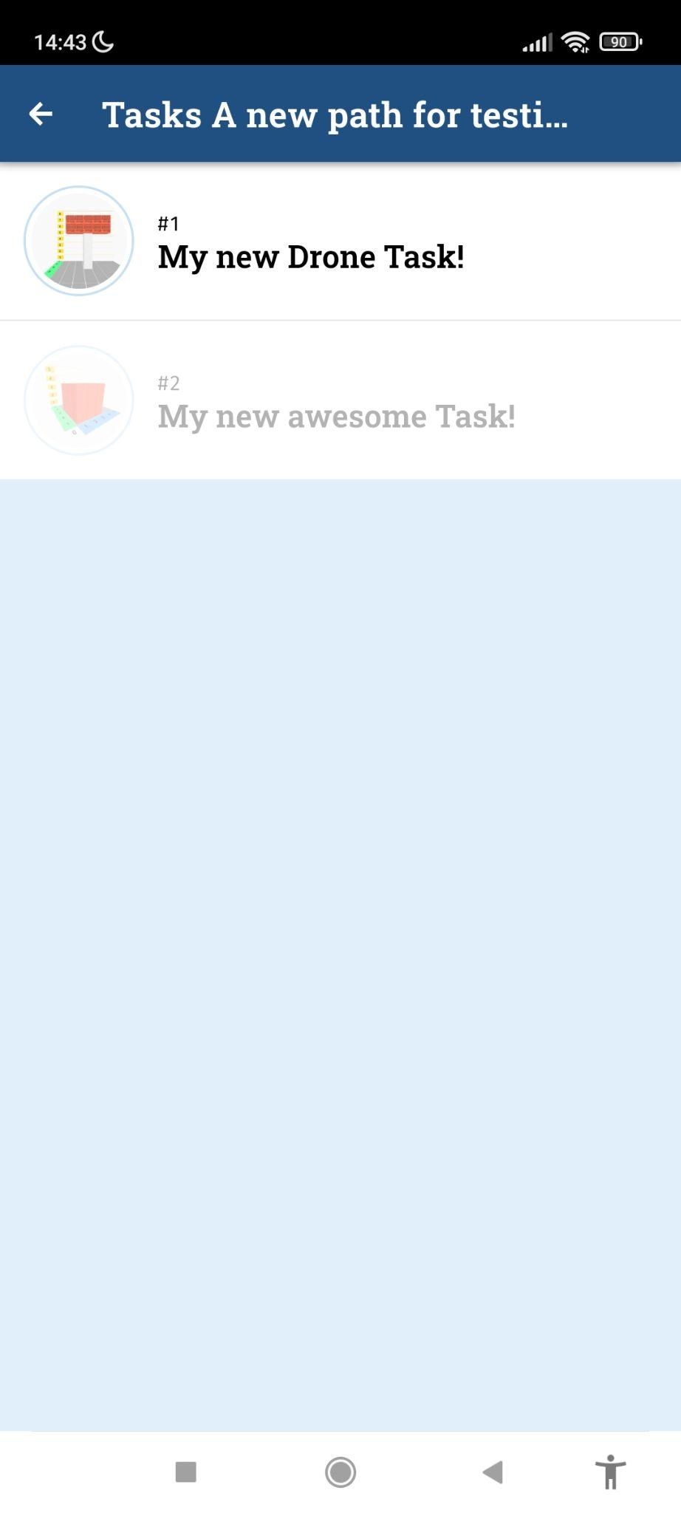
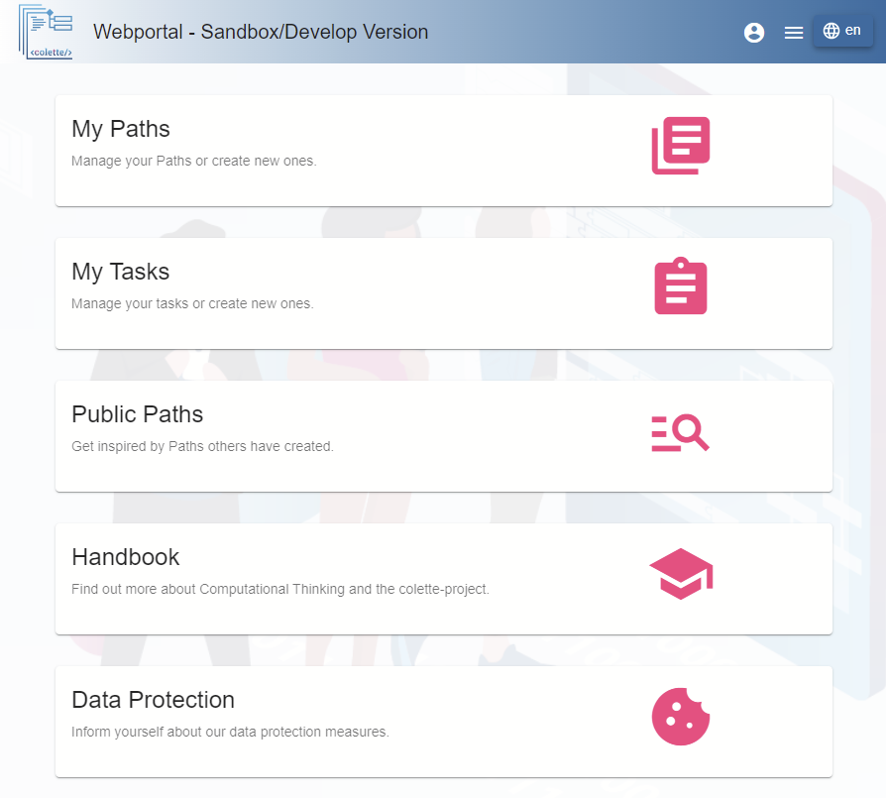
Notes:
(NOTE: Update screenshots!) Here we see the two components that <colette/> consists of. From the first module you should be already familiar with the <colette/> application aimed to students - you can see it here on the left side of the slide. On the right hand side you see the web portal which is an online system where teachers can create and manage tasks based on templates given and put them together into paths, which is a bundle of tasks that appear for students in a certain teacher-chosen sequence.

Slide 8
Web Portal
We worked in the app (in role of students) on a sequence of tasks called Path
In the Web Portal such paths can be
Created
Filled with tasks
Add tasks from task templates
Edited
Modify tasks
Modify sequence of tasks
Managed
Make shared or private
Delete
The Web Portal also includes a Handbook
Notes:
(NOTE: Update screenshots!) In the first module you all worked on tasks that were sequenced in a path in the app. Teachers can create such paths in the web portal and fill them with tasks from task templates that they can modify to their liking. So you can use the web portal for creating, editing, and deleting task paths. You will not create the tasks from scratch since there are already some developed task templates in the portal, however you can modify these task templates, create a task description and name the the tasks as you want.

Slide 9
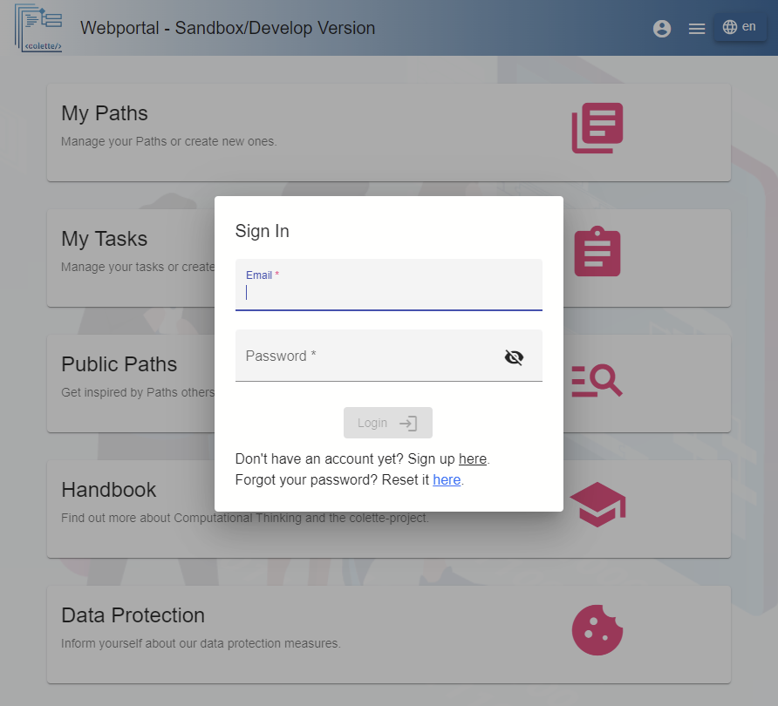
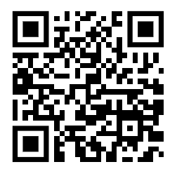
Registration
https://sb-colette-portal.matismedia.eu/#/
Notes:
Only registered users are able to create and edit paths and tasks. To register please either click the account icon on the top right or try to access content - because then you get presented with the login dialog. Here you can log in, or if you’re new, sign up (next slide) https://sb-colette-portal.matismedia.eu/ will be changed somehow in January.

Slide 10
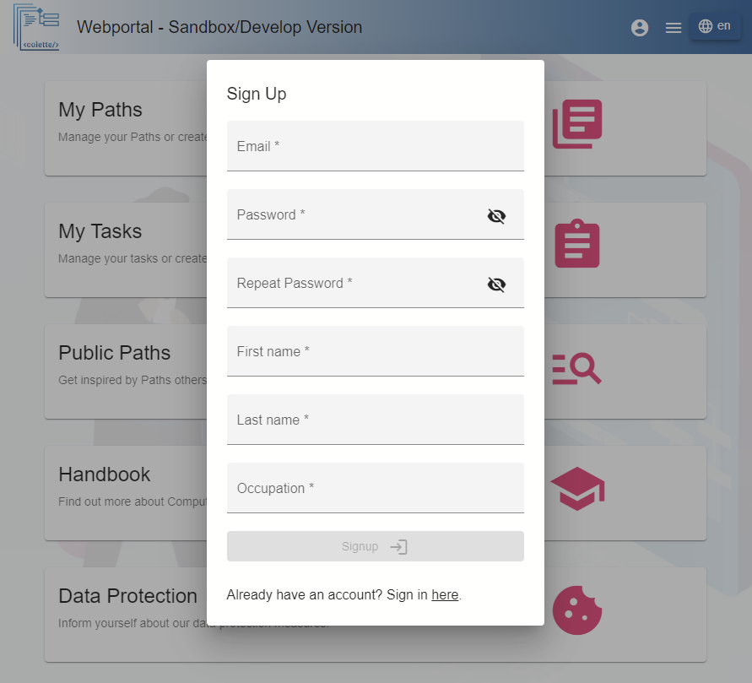
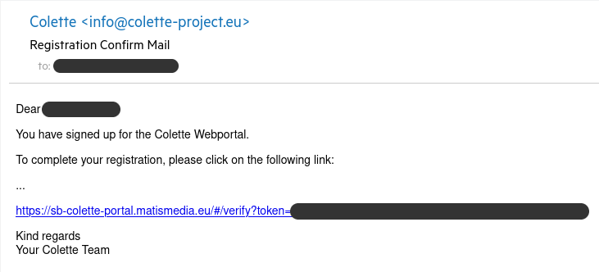
Registration confirmation
https://sb-colette-portal.matismedia.eu/#/
Notes:
(NOTE: Update screenshots!) Please, fill out the requested information for registration and confirm your Email via the link that will be sent to you as soon as you hit the Signup button.

Slide 11
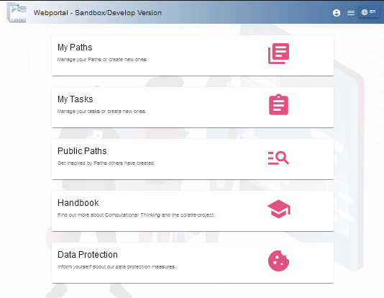
Login
Notes:
Please log in after you confirmed your registration with the credentials you have filled in. Afterwards you can access public paths and create your own content based on task templates.

Slide 12
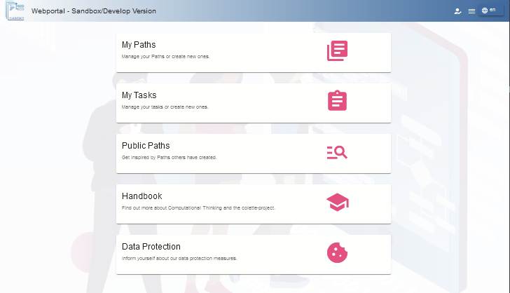
The Web Portal
Notes:
From the main page you can choose to work on your tasks, your paths or to check out public paths that other users have made. In My paths you can search for tasks, select task types and edit, and thus manage your tasks and paths. In the public paths you can browse the published paths and adapt them for your own teaching.
On the main page click on the Handbook Icon (Learn more about Computational Thinking) to get to the Handbook.

Slide 13
Public Paths
Select Public Paths and look at any given path.
Notes:
Please now select public paths to view a path someone has made.

Slide 14
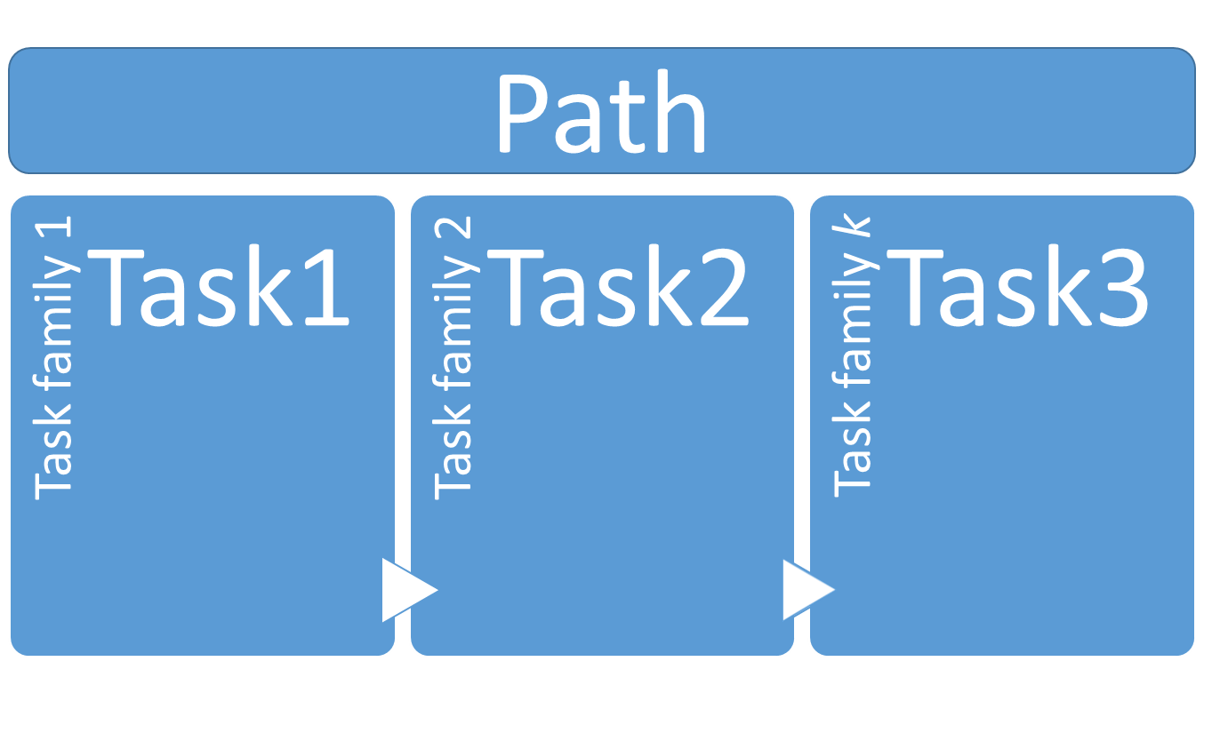
What is a Path
Notes:
A path consists of a sequence of tasks. These tasks are problems that students can solve at their own individual pace in the app. Each task is based on a task template of some specific type that we call a scenario and belongs to a task family. There are 8 task families and each family has a variety of templates that are called scenarios.

Slide 15
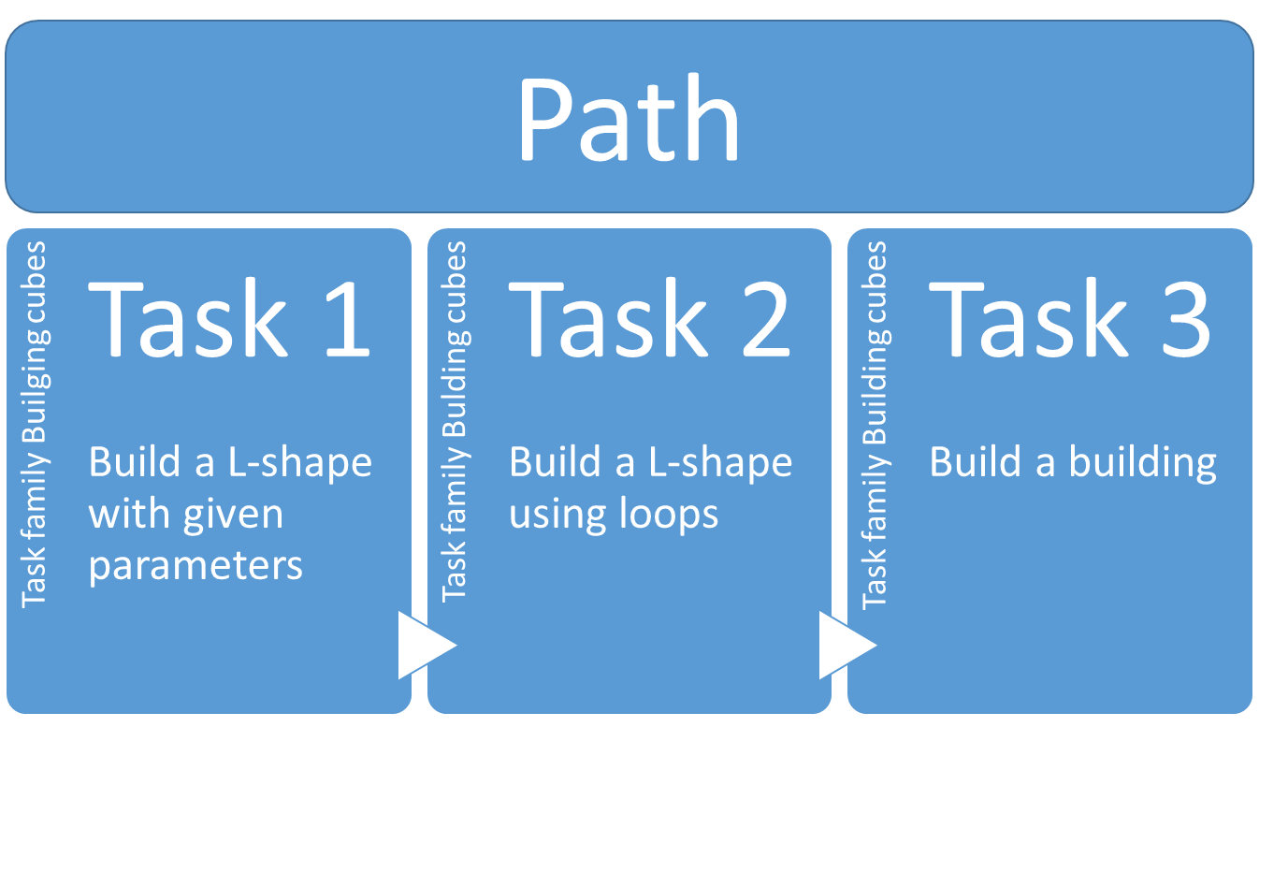
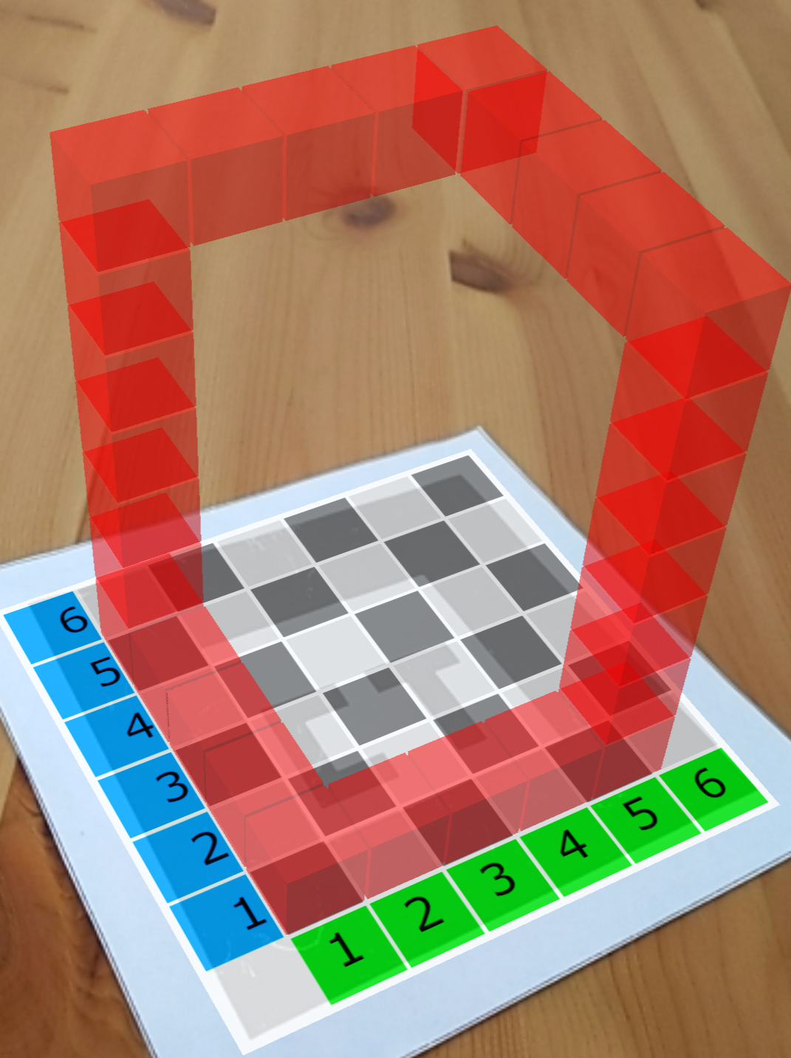
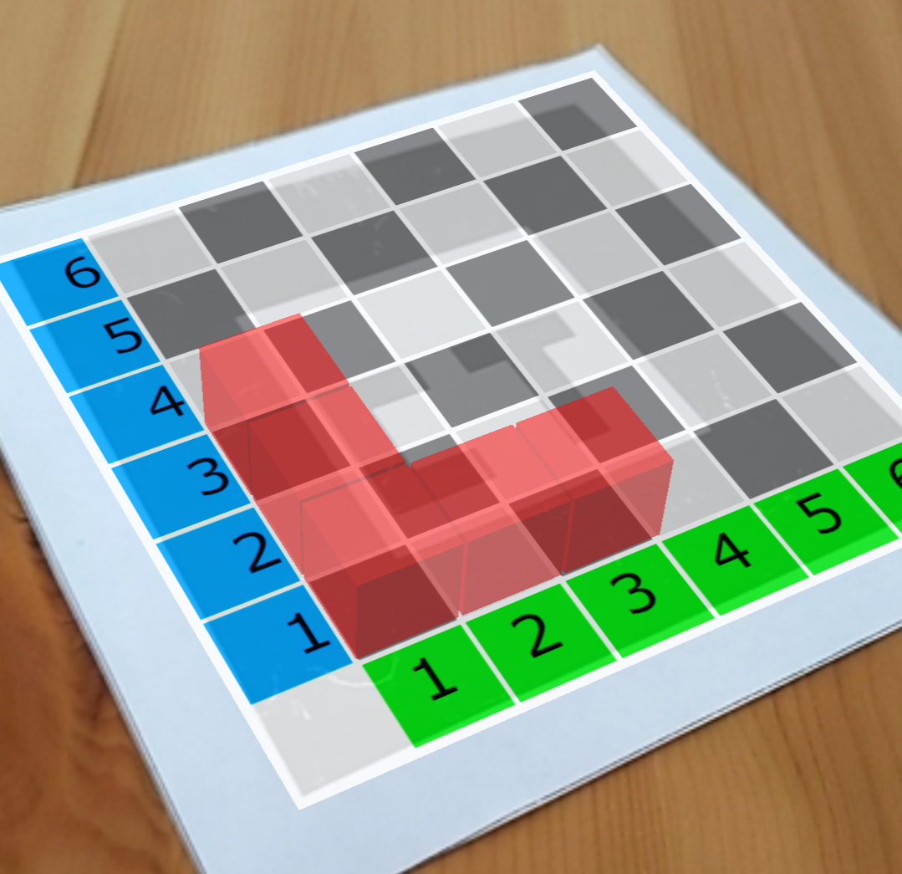
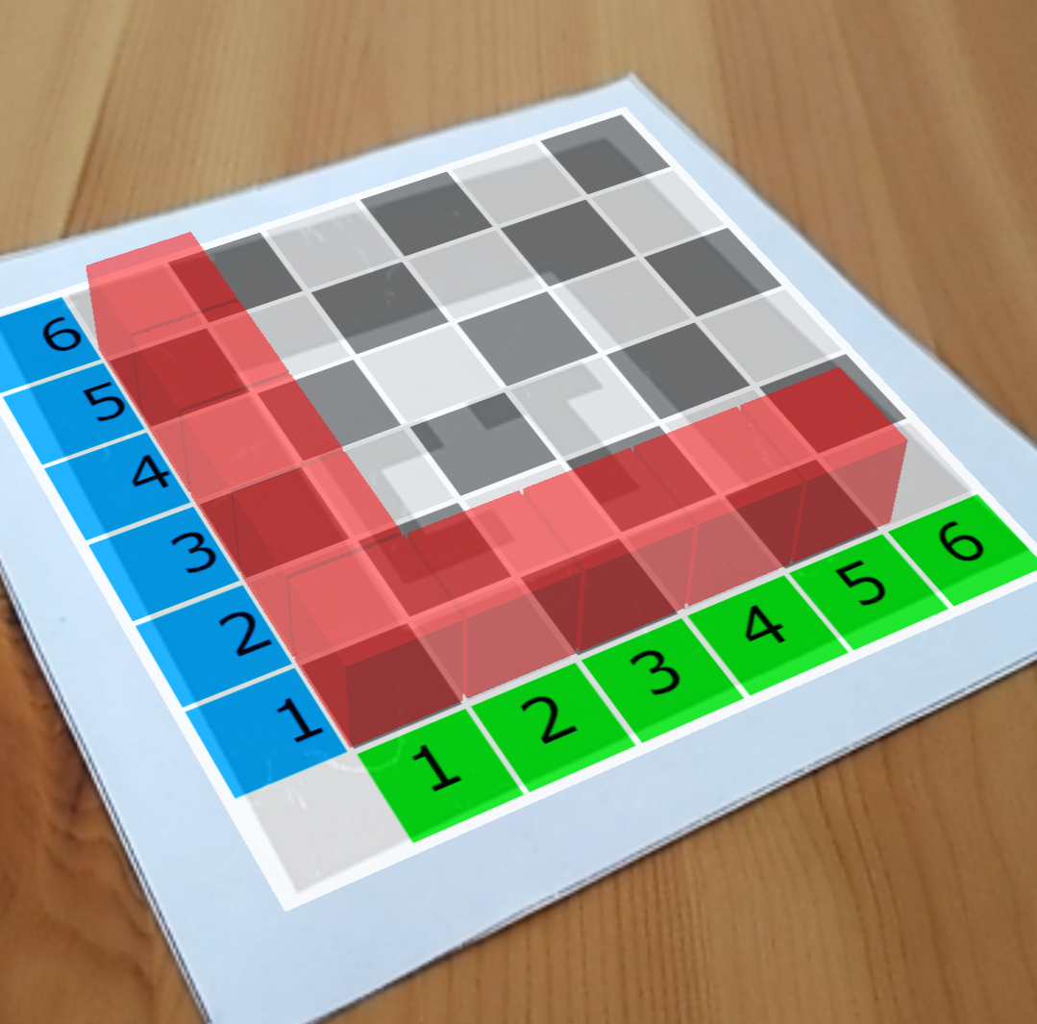
Notes:
A path consists of a sequence of tasks. These tasks are problems that students can solve at their own individual pace in the app. Each task is based on a task template of some specific type that we call a scenario and belongs to a task family. There are eight task families and each family has a variety of templates that are called scenarios. The tasks in the ice-breaking path are from Task family Building cubes and scenarios L-shape and Building.

Slide 16
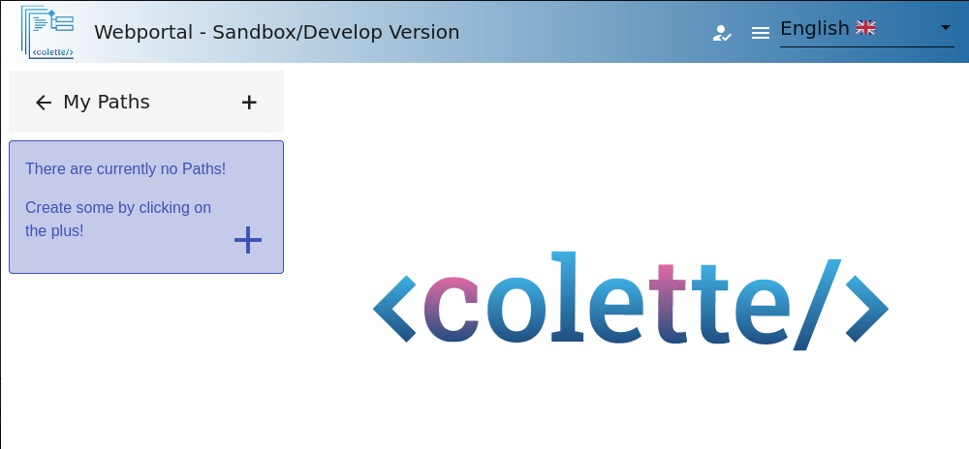
My Paths - Create the new Path
Notes:
(NOTE: Update screenshots!) Now after seeing an already created path by someone in the Public Paths section, please click on “My paths” to catch a glimpse of what can be done there. You will be able to view your own paths, or, if you don’t have any paths yet, you will see a little hint box. Now please click on the plus sign to create a new path.

Slide 17
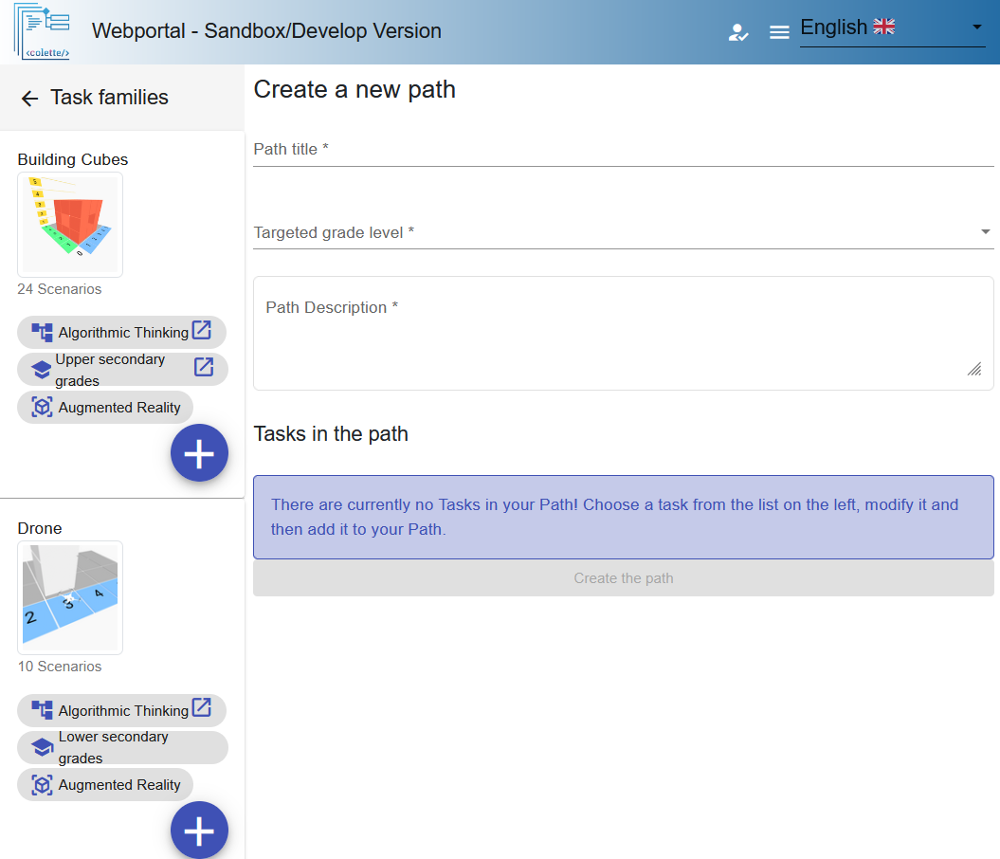
Fill in information about the new Path
Notes:
We have to start by filling the information about the new path. Please take some time to add Path title and Path Description!

Slide 18
Adding a Task to the Path
Each Task Family includes different task templates that are called Scenarios.
Notes:
After adding the title and description, you can see that on the right your new path’s content will be shown. We still need to add some content! Take a look at the left side. From here you can select what type of a task you will be adding to your path by clicking the plus sign next to it. A path is made out of tasks and each task is a specific problem that the students will solve using the app. These tasks are organized into different task families of similar tasks. The available task families are shown with a logo and some keywords. These task families include task templates for you to fill your path with. Now, let us all add a Building Cubes Task to our path. (next slide)

Slide 19
Add task: Our selected Task family is the Building Cubes
Notes:
For example, the Building Cubes task family contains tasks where students are asked to build a structure with cubes. (next slide)

Slide 20
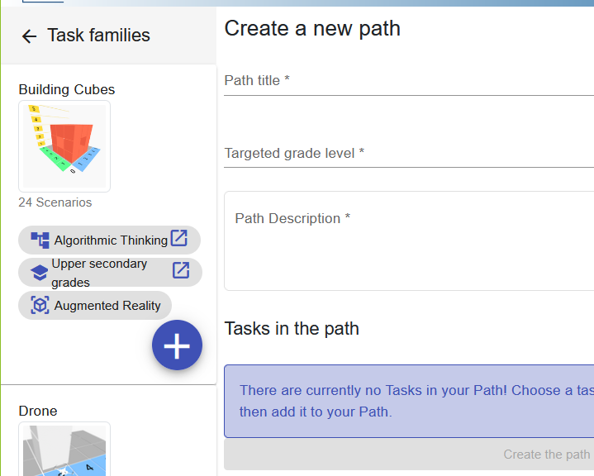
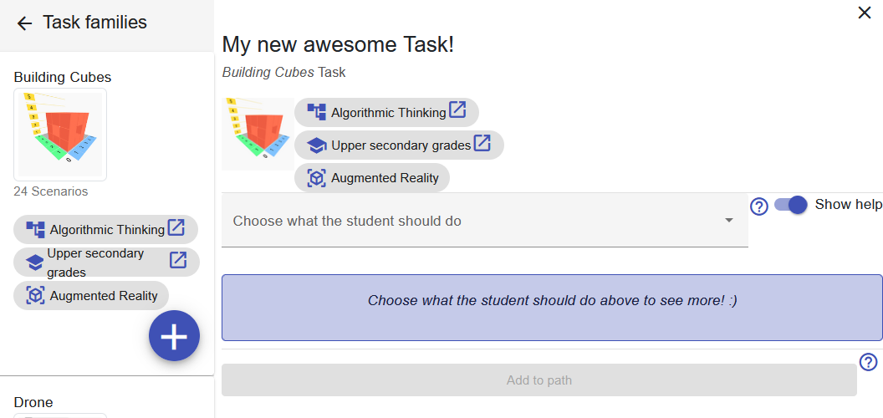
Add a new task
Notes:
Now if you haven’t already, please go ahead, press the plus button and start filling in information about your new task. (next slide)

Slide 21
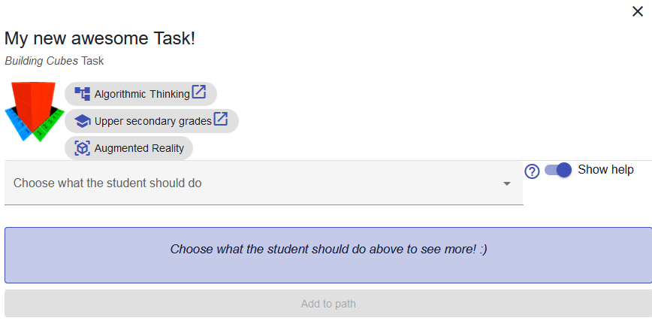
Types of task definitions: What the student should do
Implementation
Parsons puzzle
Find the error
We select “Implementation”
Notes:
For each task you can select what the student should do to solve the problem. For example, you can select that students should “Implement code” which means that they should select and stack the code blocks to create their code. We will select that for now, as Parsons puzzle and Find the error are not available in the portal yet. Parsons puzzle would mean that the code blocks are provided and students need to re-arrange and piece them together. Find the error would mean that students detect an error in the code and correct it. So, let us all select “Implementation” (next slide)

Slide 22
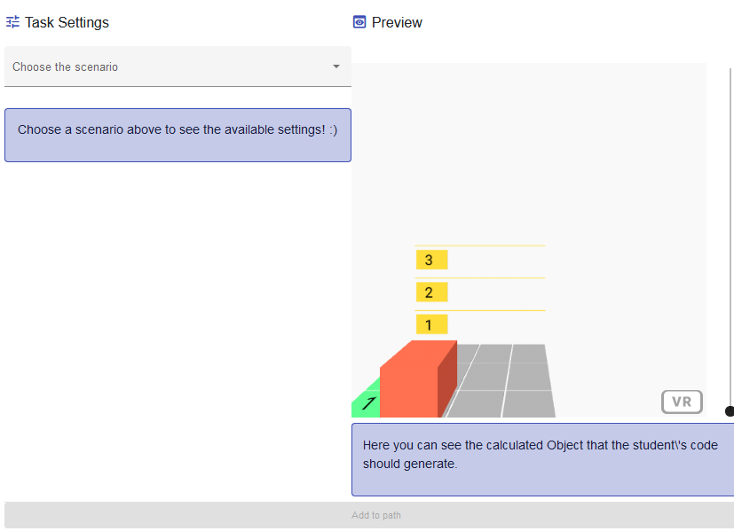
Select the shape to be built: Choose the Scenario
Scenarios available for the Building Cubes task family:
L-shape
Cube
Car
Cube Wireframe
Tower
Cuboid
Gate
(Hollow) Pyramid
(Hollow) Prism
Symmetrical corner
Tunnel
Stairs
Corner Stairs
Pavilion
Shelves
Spiral
CT Logo
Chair
House (front)
Hourglass
Let us all select the L-shape for this module’s demo.
Notes:
In the next step you have to select a pre-existing template - a so-called scenario - as your starting point. For the Building Cubes task family, the scenarios provide different shapes. A list is shown here on the slide. Let us all please select the L-shape for the purpose of this module demonstration. (next slide)

Slide 23
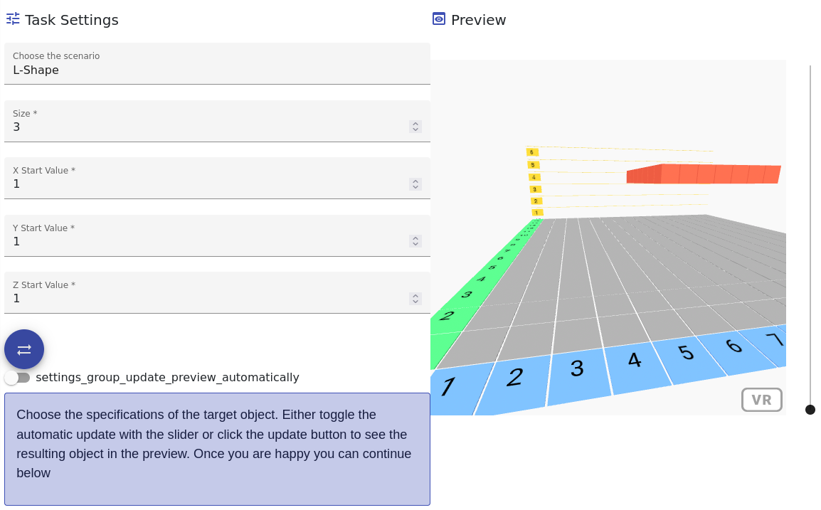
Modify the Task Settings and see the Preview
Notes:
Now please customize your task by changing the numbers in the Task Settings. (TODO add reasons and examples of customization - I would ask Sylvia to do this, as she is the author of the Task Family, e.g. familiar with the background)
Sylvia: If the shape is larger, there is an increasing need to use repeat blocks and variables and thereby make the code more efficient. Varying the starting position will increase the difficulty with respect to understanding and using the coordinate system and addresses the use of spatial skills, for example by making the shape float (z > 1).

Slide 24
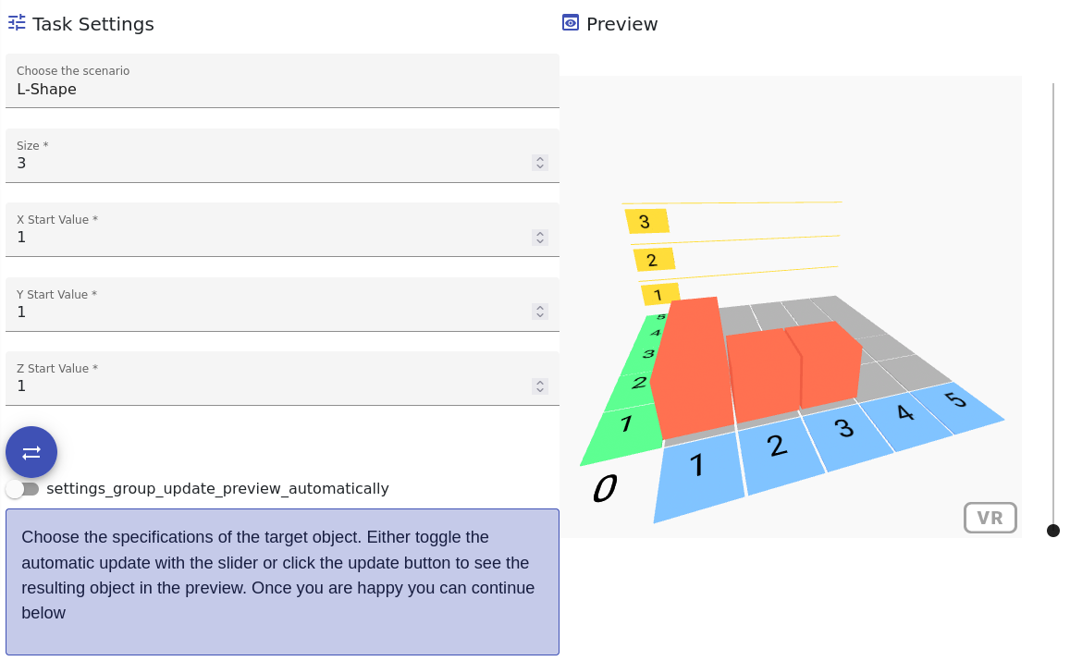
Update the Preview to show the changed Task Settings
Press
Notes:
By clicking on the arrow-both-ways button you can update the snapshot-image view on the right and thus update the front page image for the task. Changing the slider below it will update the preview in real-time. However, beware! Large amounts of cubes may cause some lag - depending on your computer capacity - so automatic update is only advisable if there is a small amount of cubes or if your computer has good capacity for working memory. After you changed the task settings, press the arrow-both-ways button!

Slide 25
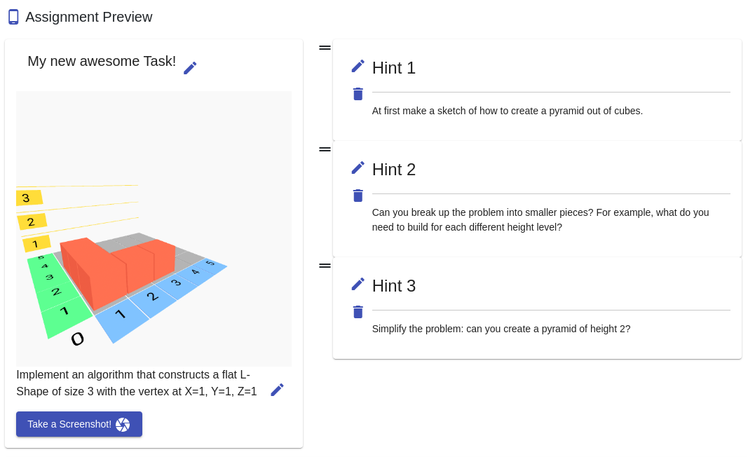
Edit the wording and picture in Assignment Preview
Edit the task title
Edit the Hints
Edit the task definition
Make a new picture for the task
Notes:
The pen icon symbolizes that you can edit the corresponding element - Here you can edit the Title, Problem definition, and Hints. You can also rearrange the hints by clicking and dragging the handle that you see here circled with a blue oval shape. Taking a new screenshot of the current preview window is possible via the button at the bottom left

Slide 26
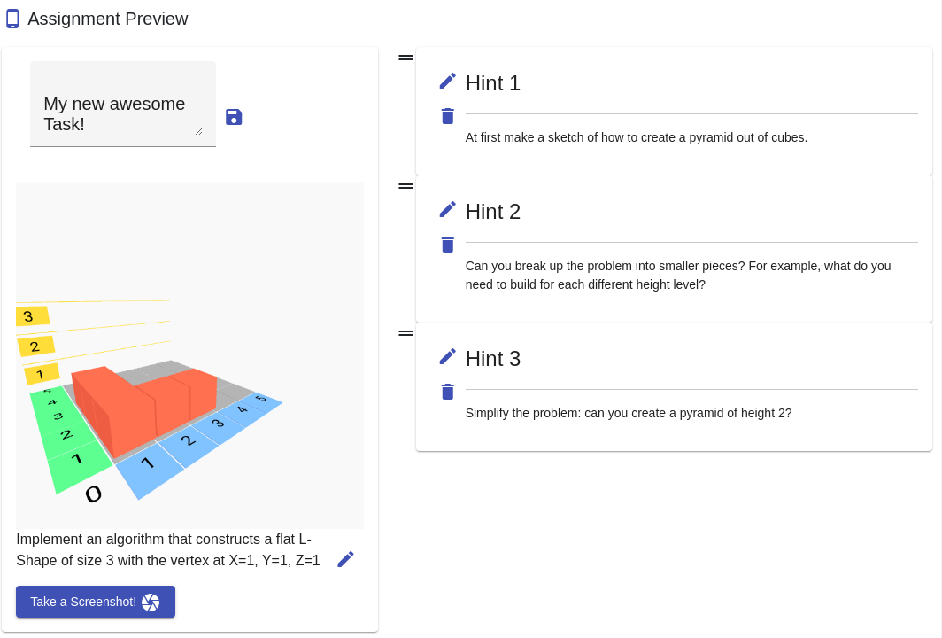
Don’t forget to save any changes you have made
Notes:
Every editing is done via a form field. These sadly do not upload automatically. The edits have to be saved, otherwise your edits may get lost!

Slide 27
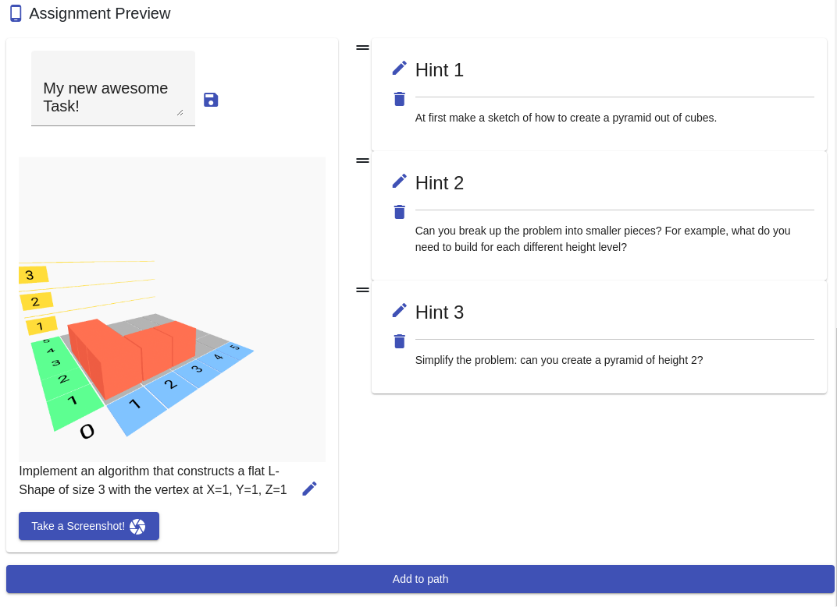
When satisfied - Add to Path
Notes:
When you have finished designing your new task, you can add it to the current path to include it in a lesson.

Slide 28
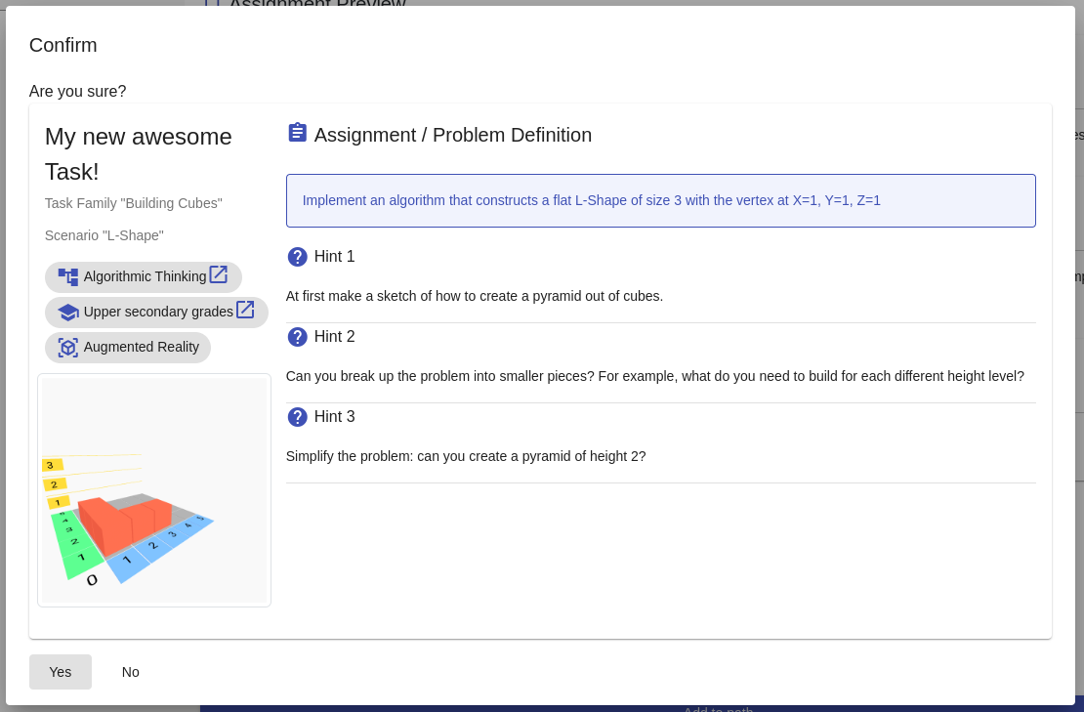
Confirm the designed task by clicking Yes
Notes:
The confirmation dialog lets you review your task, so that you don’t miss any unwanted changes. Notice that there is no need for you to provide a sample solution. The system will check automatically whether the object built by students’ blockly code fulfills the criteria or not.

Slide 29
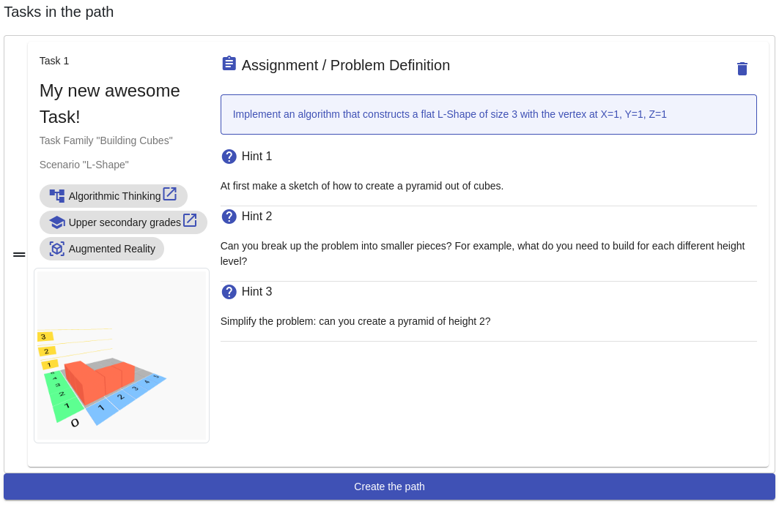
Repeat Add Task until you are satisfied with the Path and click Create the Path when ready
Notes:
Now, after finishing the first task you can go ahead - repeat the previous steps - and continue adding as many tasks as you like. When you are satisfied with the series of tasks, go on and create the path by clicking Create the Path button.

Slide 30
Handbook
Notes:
(NOTE: Update screenshots!) If you have any questions or doubts about a step in the process, you can always consult the Handbook.
To open it, go to the main page of the Web Portal and click on the handbook icon.

Slide 31
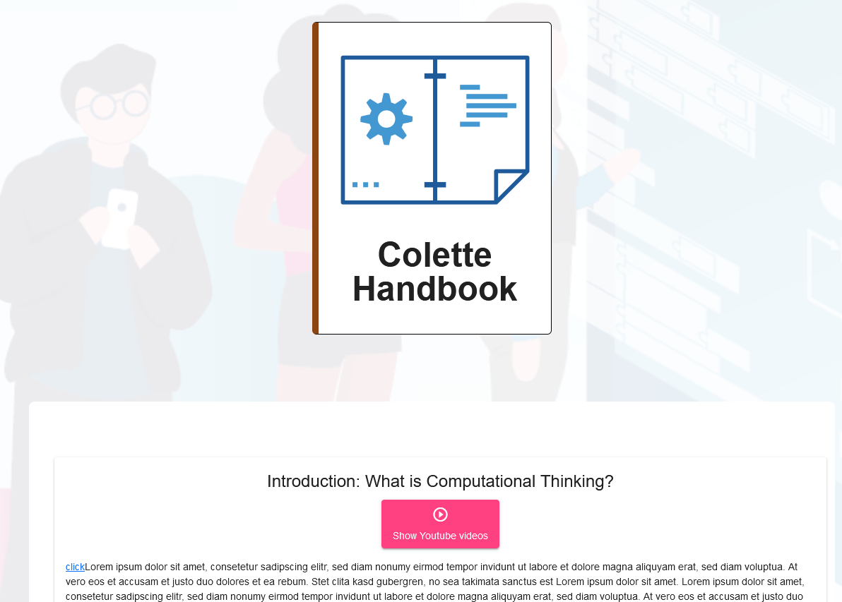
Handbook - Navigating
Notes:
Let us all open the handbook now! Scroll down to see the individual sections (click to next slide)

Slide 32
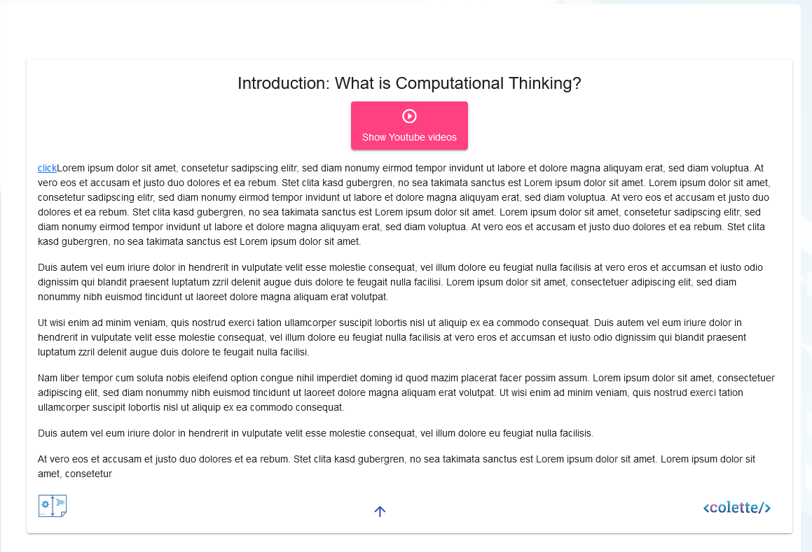
Handbook - Sections
Press here to get to the top
Notes:
Sections contain a video (under the title) and some content (text). By clicking on the centralized Arrow button you can get back to the top of the page.

Slide 33
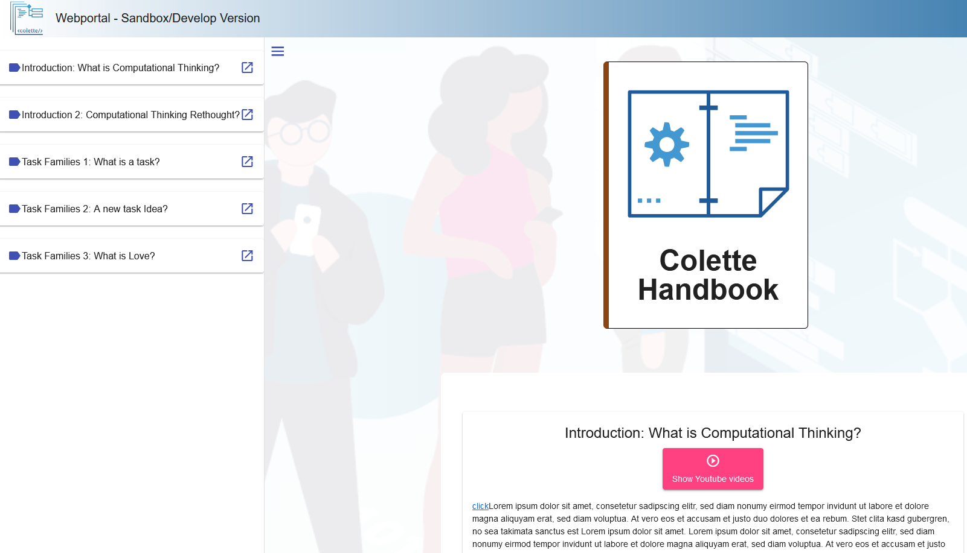
Handbook - Navigating
Press here to see navigation
Notes:
Navigation is also possible by opening the side panel. Clicking on a heading gets you to the corresponding section.

Slide 34
Outlook
Notes:
In the next module No.3 you will dig deeper into how to use the web portal and gain insight into how to create a path based on your aims and goals for the lesson.

Slide 35
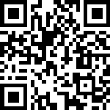
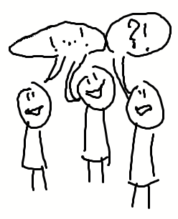
Reflection and Feedback
Please share your feedback in the Ekimo or Padlet
Comments
Questions
Keywords
What you noticed (e.g. Aha-moments)
What you wonder (e.g. what you would like to learn more about)
https://app.edkimo.com/feedback/gulhawu
Notes:
(NOTE: include QR code for Ekimo/Padlet etc. in the presentation) To conclude this second module and prepare for the third module, please add your feedback to his padlet!

